Slide 1
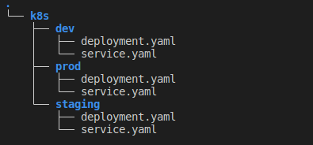
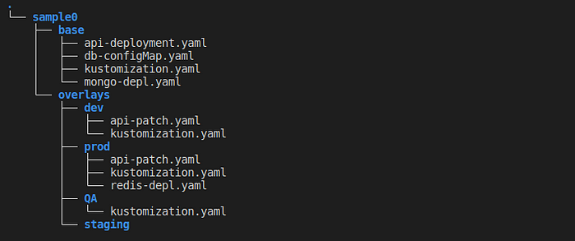
KUSTOMIZE
What is Kustomize?
Kustomize is a solution for:
Customizing Kubernetes resource configuration free from templates and DSLs.
TEMPLATE: yaml template, json, helm
DSL: Pulumi, Kotlin
Customizing raw, template-free YAML files for multiple purposes, leaving the original YAML untouched and usable as is.
Kubernetes
Understands and can patch kubernetes style API objects
It’s like make, in that what it does is declared in a file, and it’s like sed, in that it emits edited text.
Kustomize traverses a Kubernetes manifest to add, remove or update configuration options. Kustomize can be used to create manifest files for every environment from a base manifest file. i.e., If we have a set of manifest file for a certain environment, we can use Kustomize to make necessary changes to those manifest files and use that for other environments, without creating multiple copies of the base manifest files.
From Individual manifests
To
K(c)ustomize

